Slide 1



Practical Approach to Common Gynecological Conditions in General Practice
Dr Fulufhelo Tshivhula
Specialist Gynaecologist
Polokwane
Suite no. 5, Netcare Pholoso
015 296 5124

Slide 2



Slide 3
Common Conditions
Dysmenorrhoea
Endometriosis
Abnormal Uterine Bleeding
Fibroid uterus

Slide 4
Through History Taking
Age and Parity
Menstrual history, LMP
Sexual
Cervical smear history

Slide 5
Investigations
Pregnancy test
Urine dipstics
Ultrasound pelvis
Cytology smear

Slide 6
Dysmenorrhoea
Painful menstruations

Slide 7
Dysmenorrhoea
    Primary
Spasmodic painful menstrual cramps
No underlying organic pathology
Secondary
Endometriosis
Ovarian cyst
PID
Fibroid

Slide 8
Primary Dysmenorrhoea
Onset a few years after menarche
Regular cycles
Pain for less than 2 days
Cramping pain
Nausea
Radiation to thigh
Relieved after childbirth, but may recur after some years

Slide 9
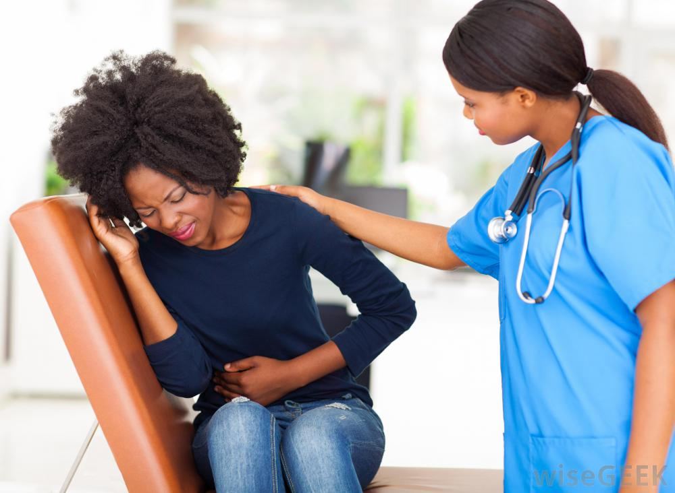

Slide 10
Management
Lifestyle Modification
Pharmacological
Surgical

Slide 11


Slide 12
Medical Treatment
Simple analgesics: Paracetamol, NSAID,Enoloic acids
Hormonal therapy: Combined OC pills (low EE), Injectable Progestogens, IUCD

Slide 13
Surgical
LUNA- Laparascopic Uterosacral Nerve Ablation and Prescral neurectomy

Slide 14
Secondary Dysmenorrhoea
Treat according to the course

Slide 15
Endometriosis
Chronic disease where endometrium tissue is found elsewhere in the body

Slide 16
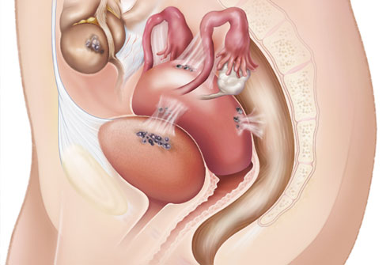

Slide 17
Common Types Endometriosis
Peritoneal endometriosis
Ovarian endometriosis
Recto-vaginal endometriosis.

Slide 18
How does it causes pain
The endometrial tissue respond to normal cycle hormones and the also menstruate
In the ovary it forms a cysts called endometrioma
Rectum nodules
Tubes- obstruction and hydrosalpins

Slide 19
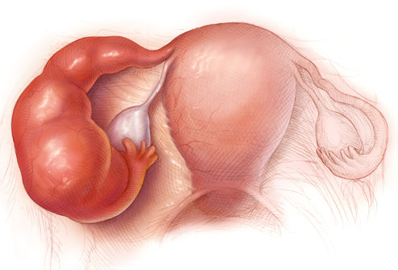

Slide 20
Causes of Endometrios
The cause of endometriosis is unknown.
Retrograde menstruations
Coelomic metaplasia
Iatrogenic Disseminations
Familial and Genetic

Slide 21
Pelvic Scans
Although it isn't possible to confirm endometriosis with scanning techniques alone
CT scan, or MRI to help with diagnosis
These may be able to detect larger endometrial growths or cysts.

Slide 22
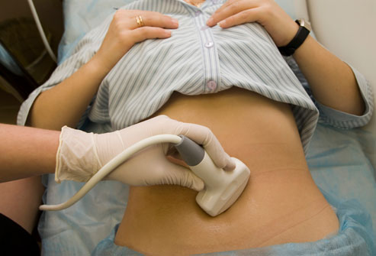

Slide 23
How is Endometriosis Treated?
The goals
Pain relief and/or
Enhancement of fertility

Slide 24
Decision is base on
Fertility
Not for Fertility
Surgical intervention
Laparascopy
Medical
Hormones Treatments

Slide 25


Slide 26
Hormonal Medications
Combine oral contraceptives
Progestogens
GnRH

Slide 27


Slide 28
Dyspareunia
Adenomyosis
Recto –vaginal- Nodules

Slide 29
Heavy Period
Enlarge womb ( Adenomyosis)

Slide 30
Infertility
Abnormal hormonal function,
Infrequent intercourse (pain),
Affected sperm transportation,
Tubal blockage,
Ovarian damage following surgical treatment.

Slide 31
Endometriosis Thinks of
Painful Periods
Heavy Periods
Pelvic Pain
Painful intercourse
Infertility

Slide 32
Hysterectomy
TAH+BSO will definitely cure the problems

Slide 33
Menopause
Generally, the onset of menopause usually results in the decrease of endometriosis.
However, severe endometriosis can be reactivated by HRT or continued hormone production after menopause.

Slide 34
Uterine Fibroids
Common
25-30% of women over 35
Often asymtomatic
Incidentally detected on pelvic ultrasound

Slide 35
Uterine Fibroids
Symptoms
Abnormal Uterine Bleeding
Chronic Pelvic Pain
Infertility
Abdominal distention ( Pressure )

Slide 36
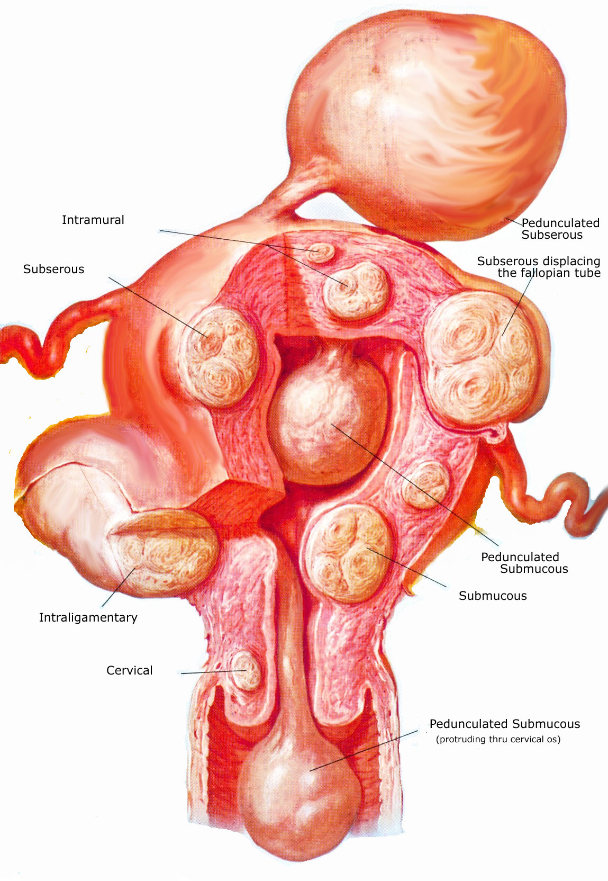

Slide 37
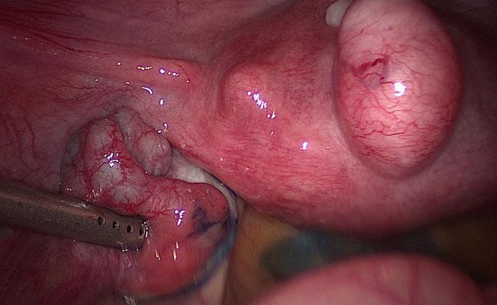

Slide 39
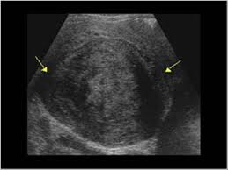

Slide 40
Treatment
Surgical: Myomectomy and Hysterectomy
Medical treatment with GnRH analogue
  shrink fibroids before surgery
  buy time before menopause
Embolization

Slide 41
Post-Myomectomy
Fibroids can recur after myomectomy
Advice for pregnancy?
  Caesarean delivery

Slide 42


Slide 43
Abnormal Uterine Bleeding
Normal Menstruation cycle 21-35 days
2-8 days of bleeding
Less than 80ml

Slide 44
What is Abnormal
            Bleeding between periods
            Postcoital
Spotting anytime
Menopousal bleeding

Slide 45
Terminology no longer used
Metrorrhagia
Menometrorrhagia
Hypomenorrhoea
Polymenorrhoea
Oligomenorrhoea
Menorrhagia

Slide 46
What Causes Abnormal Uterine bleeding

Slide 47
Abnormal Pregnancy state
Ectopic
Abortions

Slide 48
Genital Tract Pathology
Fibroids
Polyps
Adenomyosis
Endometrial hyperplasia
Infections

Slide 49
Iatrogenic
Hormonal contraceptives
IUCD
Drugs

Slide 50
Abnormal Vaginal Bleeding
Malignancies?
  Carcinoma of corpus
  Carcinoma of cervix
  Oestrogen producing ovarian tumour
Premaligant conditions?
  Atypical endometrial hyperplasia
  CIN (usually do not present with bleeding)

Slide 51
Dysfunctional Uterine Bleeding

Slide 52
Management
Detail history
Examination– Severe Anaemia
-Bleeding disorder
-Hyper/hypo estogenism
Pelvic examination

Slide 53
Acute Bleeding
Haemodynamic stabilisation
Blood transfusion
Antifibrinolytic

Slide 54
Special Investigation
HB
Cervical cytology
Endometrial sampling
Ultrasound ( vaginal probe)
Hysteroscopy
Saline infusion hysterography

Slide 55
Hormonal Therapy
Oral Progestogens
High dose oestrogen contain contraception
IUCD
GnRH analogues

Slide 56
Surgical
Uterine curratage
Endometrial ablation
Hysterectomy

Slide 57
When to consider medical treatment as failure?
Failure to relieve patient’s symptoms after 3 months
Remains anaemic after 3 months

Slide 58
Abnormal Vaginal Bleeding
When to refer:
Over the age of 40
High risk of endometrial Ca (obesity, DM,HRT)
Uterus > 10 week size or irregular
Cervical pathology suspected
No response to medical treatment

Slide 59
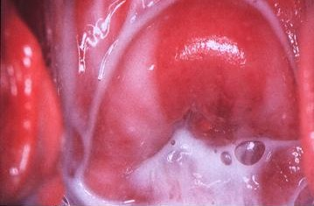

Slide 60
Vaginal Discharge
Physiological:
  midcycle, premenstrual
Pathological:
  odour, itchiness
  blood stained
Postmenopausal: atrophic vaginitis

Slide 61
Vaginal Discharge
Speculum examination is necessary and digital examination preferred
Gram’s stain smear
Amine test
Wet mount test
Need to take culture swab?
Need to screen for STD?

Slide 62
Vaginal Discharge
Need to refer?
  Recurrent
  Blood stained and not midcycle
  Fail to response to treatment
  Uterine or cervical pathology suspected
  Postmenopausal and fails to respond to HRT

Slide 63
Vaginal Discharge
In children:
Think of foreign body
Sexual abuse
Examination under anaethesia
May need referral

Slide 64
Conclusion
Many common Gynaecological condition can be
managed by GP
Reasons for referral:
Unsure diagnosis
Special investigations???
Not responding to treatment or recurrence
Second opinion

Slide 65

Dr Fulufhelo Tshivhula
Specialist Gynaecologist
Polokwane
62 Burger street
015 291 4310

